Slide 1
Novel Gene Regulating Amygdala-Mediated Fear Extinction
Ben Onserio
Biol. 792
September 21st , 2018

Slide 2
Introduction
Highly prevalent psychiatric disorders
Traumas and stress-related disorders
- Unfortunately, they are inadequately treated
We study them using animal models
- Knockdowns- through gene transfection
Wild-types
- Understanding how animal models work can present us new therapeutic strategies

Slide 3
Bukalo et.al 2015

Slide 4
1. Does in vivo stimulation of ventromedial prefrontal cortex (vmPFC)-amygdala facilitate extinction memory formation?
2. Does silencing the vmPFC-amygdala pathway impair extinction formation?

Slide 5
Methods
- Subjects
-Male adult C57BL/6J mice
- Singly housed to maintain the integrity of intracranial implants
- Subjected to a 12-hour light/dark cycle
-Experimental procedures performed in accordance NIH guidelines
- Viral infusion and ferrule implantation
- In vivo multielectrode array recordings
- Ex vivo slice electrophysiology recordings
- Behavioral testing
- Immediate-early gene mapping
- Statistical analyses

Slide 6
Results & Discussion
Controlling the vmPFC-amygdala circuit
- Shining blue light on ChR2-expressing vmPFC cells increased local neuronal firings

Slide 7
Results & Discussion
Controlling the vmPFC-amygdala circuit
- Shining green light on ArchT-expressing vmPFC cells inhibited local neuronal firing

Slide 8
Results & Discussion
Effects of optogenetic manipulation of vmPFC inputs to the amygdala
Blue light shone on the axons of ChR2-expressing vmPFC cells in BLA generated large EPSCs
- light intensity-dependent manner

Slide 9
Results & Discussion
Effects of optogenetic manipulation of vmPFC inputs to the amygdala
Light-evoked currents at the pyramidal neurons were blocked by AMPA receptor antagonist, CNQX
- indicates that vmPFC –amygdala transmission was glutamatergic in nature
- BLA is a major physiological target of vmPFC

Slide 10
Results & Discussion
Effects of optogenetic manipulation of vmPFC inputs to the amygdala

Slide 11
Results & Discussion
vmPFC-amygdala circuit stimulation facilitates extinction formation
- Tone-evoked fear was extinguished via 50 unreinforced tone presentations
- Freezing did not differ between the ChR2 and YFP groups during either extinction training

Slide 12
Results & Discussion
ChR2-mediated excitation during extinction training facilitate long-term formation of an otherwise partially extinction memory
- This suggests that the amygdala is at least one of the principle targets mediating extinction-facilitating effects of vmPFC activation

Slide 13
Results & Discussion
VmPFC-amygdala circuit silencing impairs extinction formation from BLA
Freezing during extinction training did not differ between the ArchT and YFP groups
Freezing in the ArchT group was higher than controls during a light-free retrieval test
- a deficit in long-term extinction

Slide 14
Results & Discussion
VmPFC-amygdala circuit silencing impairs extinction formation from BLA
Freezing to the amygdala was unaltered when green light was shone during retrieval
Shows that vmPFC neurons projecting to the amygdala are necessary for long-term extinction memory formation

Slide 15
Results & Discussion
VmPFC-amygdala circuit silencing impairs extinction formation from BLA
There were fewer Zif268-positive neurons in LA and BLA of the ArchT group compared with YFP controls
Silencing vmPFC inputs to the amygdala attenuates recruitment of the LA and BLA during extinction

Slide 16
Conclusion
- Optogenetically stimulating vmPFC inputs drives glutamatergic in the BLA
- It also facilitates extinction acquisition
- Silencing vmPFC-amygdala pathway impairs extinction acquisition

Slide 17
Gogolla et.al 2009

Slide 18
1. In the amygdala, does postnatal maturation of perineuronal nets (PNNS) underlie the developmental switch in fear extinction regulation?

Slide 19
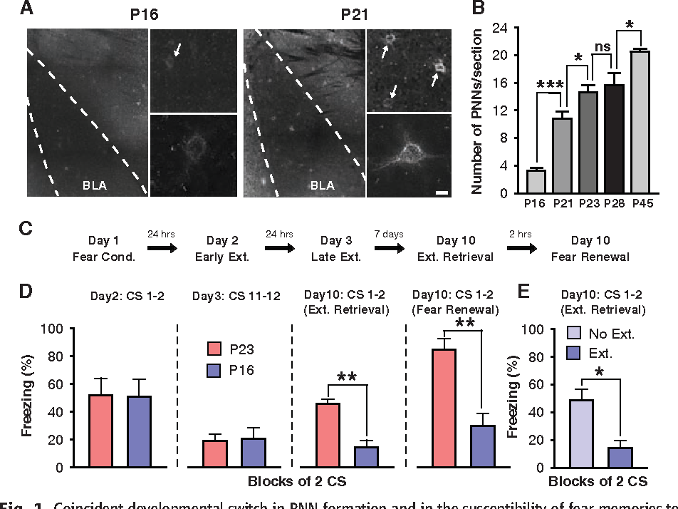
Results & Discussion
Number of detectable WFA-stained PNNs increased markedly until P28
The largest increase was between P16 and P21
Age around which the switch in the extinction phenotype occurs in rats
Both groups exhibited equal levels of freezing behavior
Mice conditioned at P23 exhibited spontaneous recovery and renewal
Mice conditioned at P16 did not show spontaneous recovery and renewal
- It retained a stable fear memory for 10 days

Slide 20
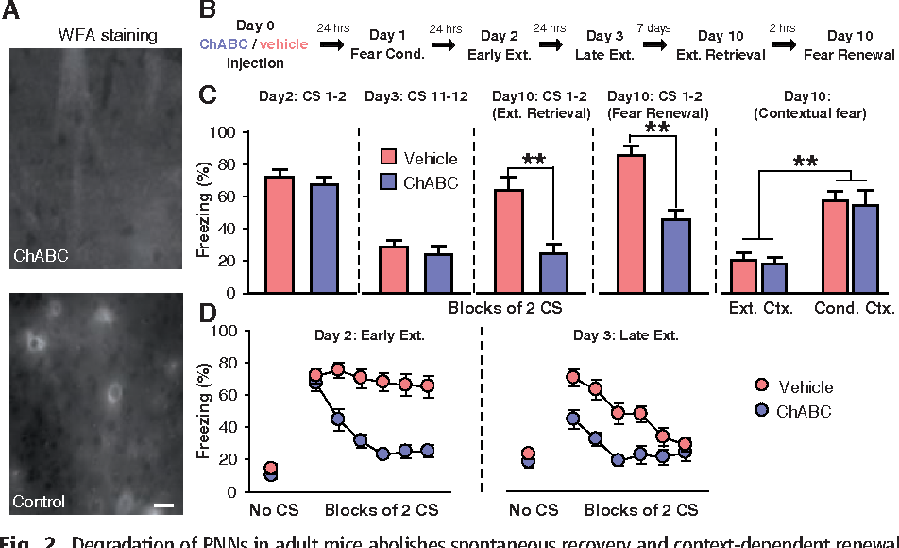
Results & Discussion
No PNNs could be detected in the BLA after ChABC injection
Normal freezing levels observed after ChABC injection
After extinction training, freezing levels were reduced in both groups
When tested 7 or 28 days later, ChABC-injected mice exhibited a complete lack of spontaneous recovery

Slide 21
Results & Discussion
Degradation of PNNs after fear conditioning did not accelerate the time course of subsequent extinction learning
Rapid extinction of a second fear memory acquired in the absence of PNNs
Mice fear conditioned 24 hours before ChABC injection exhibited normal extinction
- Showed normal levels of spontaneous recovery and context-dependent renewal after 1 week

Slide 22
Conclusion
Fear memories are actively protected from erasure by PNNs
In the BLA, formation of PNNs marks the end of developmental period during which fear memories could be erased by extinction
During early postnatal development, chances of survival may be optimized by adhering to the most recently learned information

Slide 23
Gunduz-Cinar et.al 2018

Slide 24
What is the gene associated with fear extinction in rodents?
What happens when the gene associated with fear extinction is upregulated or downregulated?

Slide 25
Methods
Subjects
Adult male C57BL/6J (B6) and 129S1/SvImJ (S1) mice
Behavioral tests
Immunohistochemistry

Slide 26
Results & Discussion
Fear and extinction QTL
- S1 mice froze significantly more than B6 mice by the final-block extinction acquisition and on an extinction retrieval test

Slide 27
Results & Discussion
Fear and extinction QTL
-Cross between B6 mice and S1 mice generated F1 generation
-From F1 breeders, F2 generation was produced in which individual mouse carried a unique combination of B6 and S1 gene variants

Slide 28
Results & Discussion
Fear and extinction QTL
F2 population demonstrated extinction behavior, reminiscent of B6 and S1 strains
There was a decrease in freezing across extinction trial-blocks

Slide 29
Results & Discussion
Fear and extinction QTL
- A QTL at the genome-wide significance level for fear retrieval on chromosome 1 and an independent QTL for extinction retrieval on chromosome 3

Slide 30
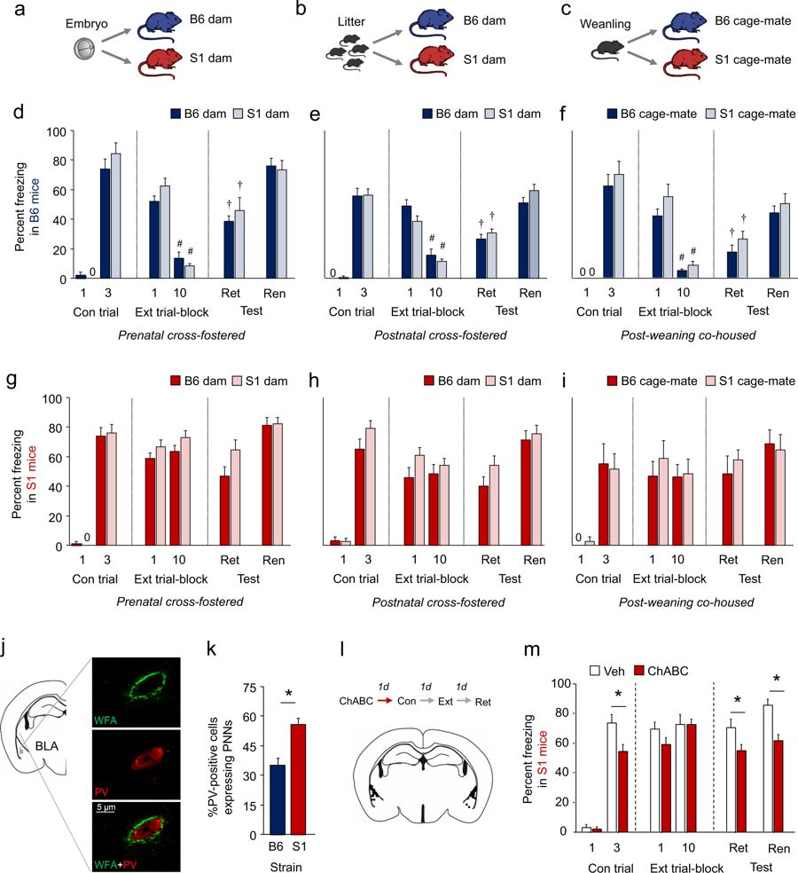
Results & Discussion
Developmental influences and differences
Regardless of developmental period, cross-fostering failed to alter the fear or extinction phenotype
As compared to control groups cross-fostered to a mouse of the same strain

Slide 31
Results & Discussion
Developmental influences and differences
Adult S1 mice had higher number of BLA PV+ interneurons surrounded by PNNs
PV+ cells surrounded by PNNs in prefrontal cortex and hippocampus are minimal

Slide 32
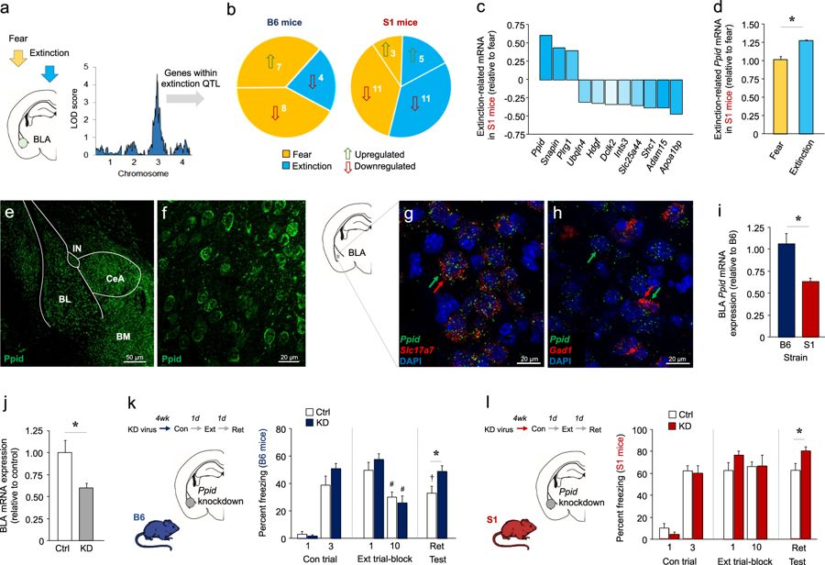
Results & Discussion
Ppid (Peptidylproply isomerase D) distribution and localization in the amygdala
Ppid is densely expressed in the BLA , CeA and BM of S1 mice
Ppid is clearly visible in both vGlut1 and Gad1 expressing neurons within the BLA
Ppid is ideally located to modulate extinction via its expression in the BLA
Excitatory and inhibitory neurons

Slide 33
Results & Discussion
BLA-Ppid knockdown reveals a causal role in extinction
In B6 mice, Ppid knockdown increased levels of freezing during extinction retrieval, but not other test-phases, as compared to transfected mice with control groups
Knockdown impaired extinction in B6
In S1 mice, Ppid knockdown produced higher freezing on retrieval, relative to viral control groups
Loss of Ppid in BLA is sufficient to disrupt extinction memory

Slide 34
Results & Discussion
BLA Ppid upregulation rescues extinction and dampens fear cell activity
Overexpressing Ppid led to decreases freezing on the final fear conditioning trial
It significantly reduced levels on extinction retrieval, as compared to mice expressing a control virus
Engineering suprathreshold levels of Ppid in the BLA is sufficient to rescue impaired extinction in S1 mice

Slide 35
Results & Discussion
BLA Ppid upregulation rescues extinction and dampens fear cell activity
Viral groups did not differ in baseline BLA neuronal firing rate
During extinction retrieval, a subpopulation of cells exhibited changes in firing rate that peaked with 50 ms of CS presentation
CS-related neuronal firing in S1 mice was blunted during extinction retrieval

Slide 36
Results & Discussion
Ppid is anatomically and functionally coupled to GR
Ppid-stained neurons exhibited staining for GR
The two protein products co-precipitated in tissue obtained from the BLA
GR gene expression in the BLA of S1 mice was lower than B6 mice
Administering of GR agonist, dexamethasone, reduced freezing on drug-free extinction retrieval
Overexpression of Ppid in the BLA led to an increase in GR gene expression in S1 mice

Slide 37
Conclusion
Ppid expressed in amygdala, GR-associated gene, plays a causal role in regulating extinction by modulating BLA neuronal encoding
Ppid is a positive modulator of GR

